Slide 1


Business Insights 360
AtliQ Hardware
Business Model
Sumit Mahato

Slide 2

AtliQ Overview
C
Atliq Hardwares, a global supplier of computer hardware and components like PC, Mouse, Printer,Keyboards etc.

Slide 3
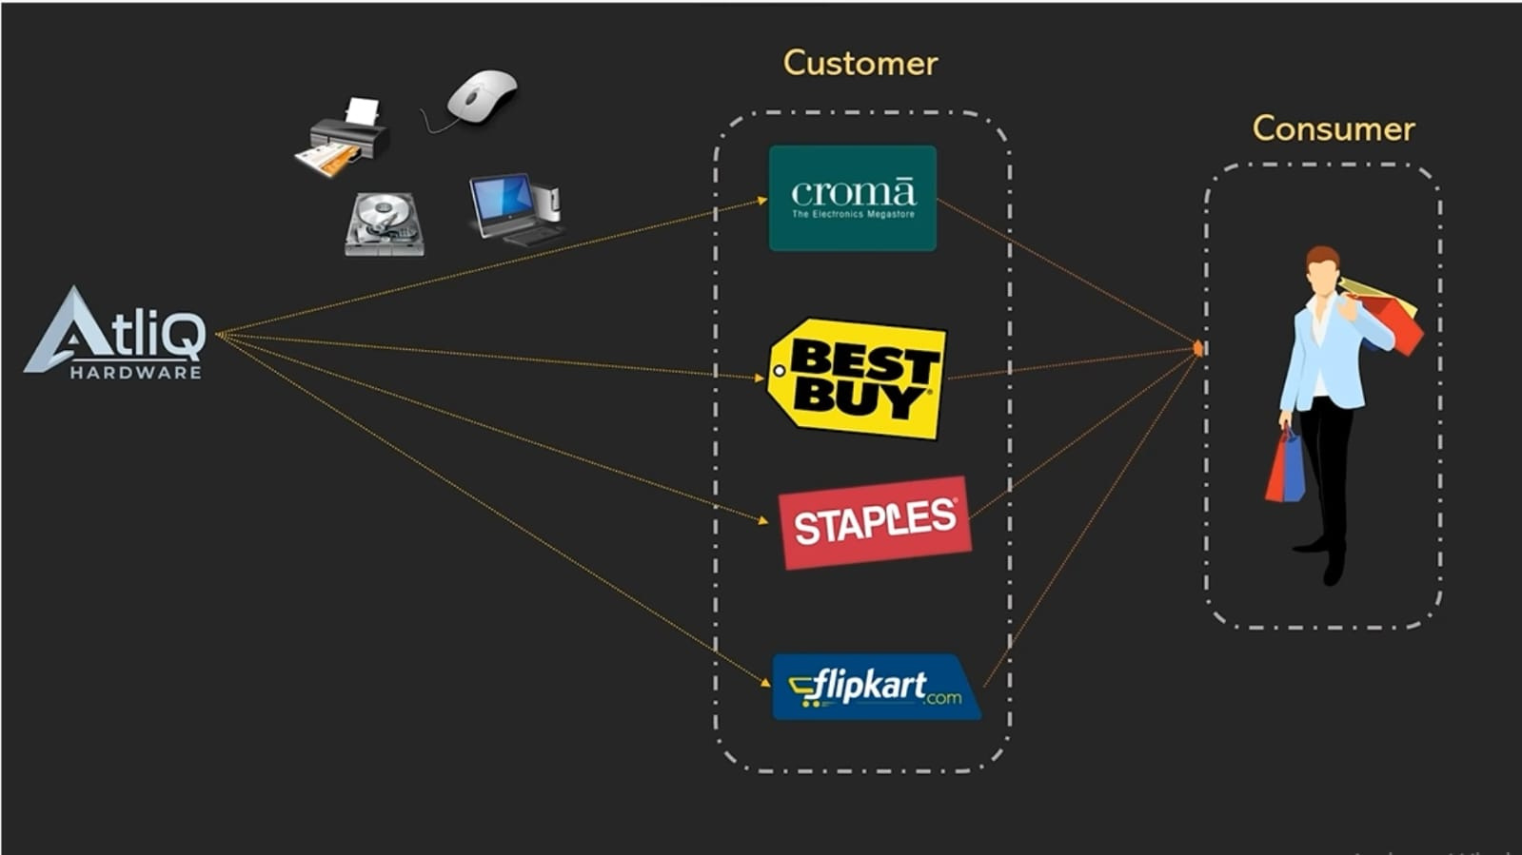
AtliQ Customer
C

Slide 4
Customer
Customer And Consumer
Customers are stores like Amazon, Croma, Flipkart
Consumer
Consumer means the end users who purchase and use the products.

Slide 5
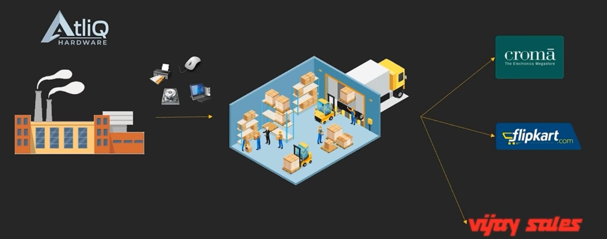
AtliQ Industry
C

Slide 6
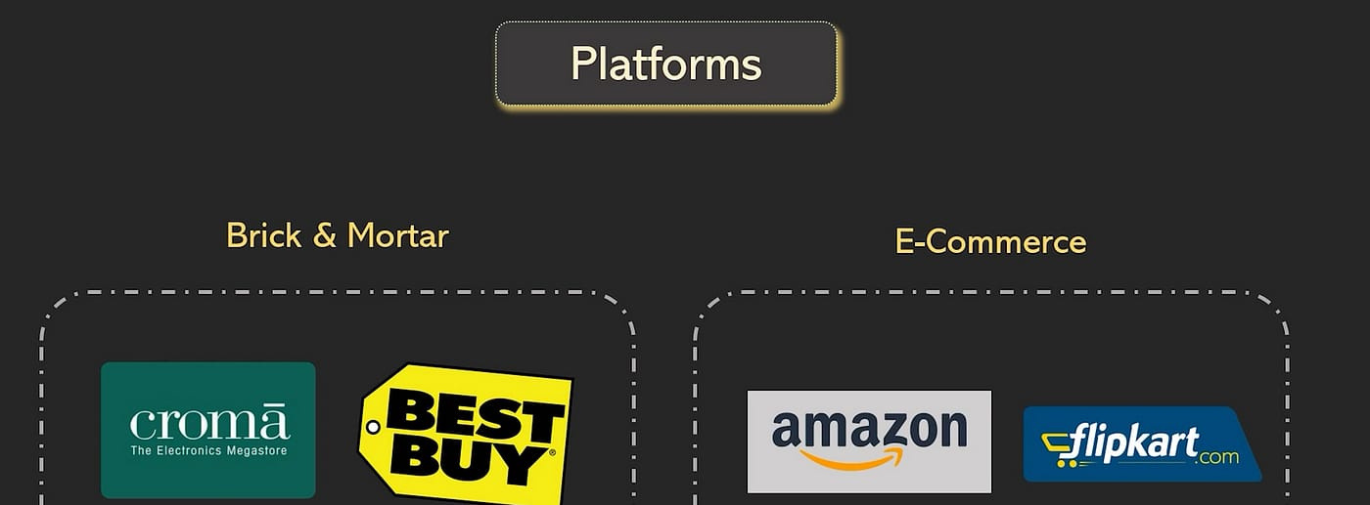
AtliQ Platforms
C

Slide 7
Platforms
AtliQ operates through two primary mediums where product interactions and sales take place: platforms.
Brick & Mortar
E-Commerce
Physical retail stores where customers can see and touch products in person, such as Croma and Best Buy.
Online marketplaces where products are sold through digital platforms, including Amazon and Flipkart.

Slide 8
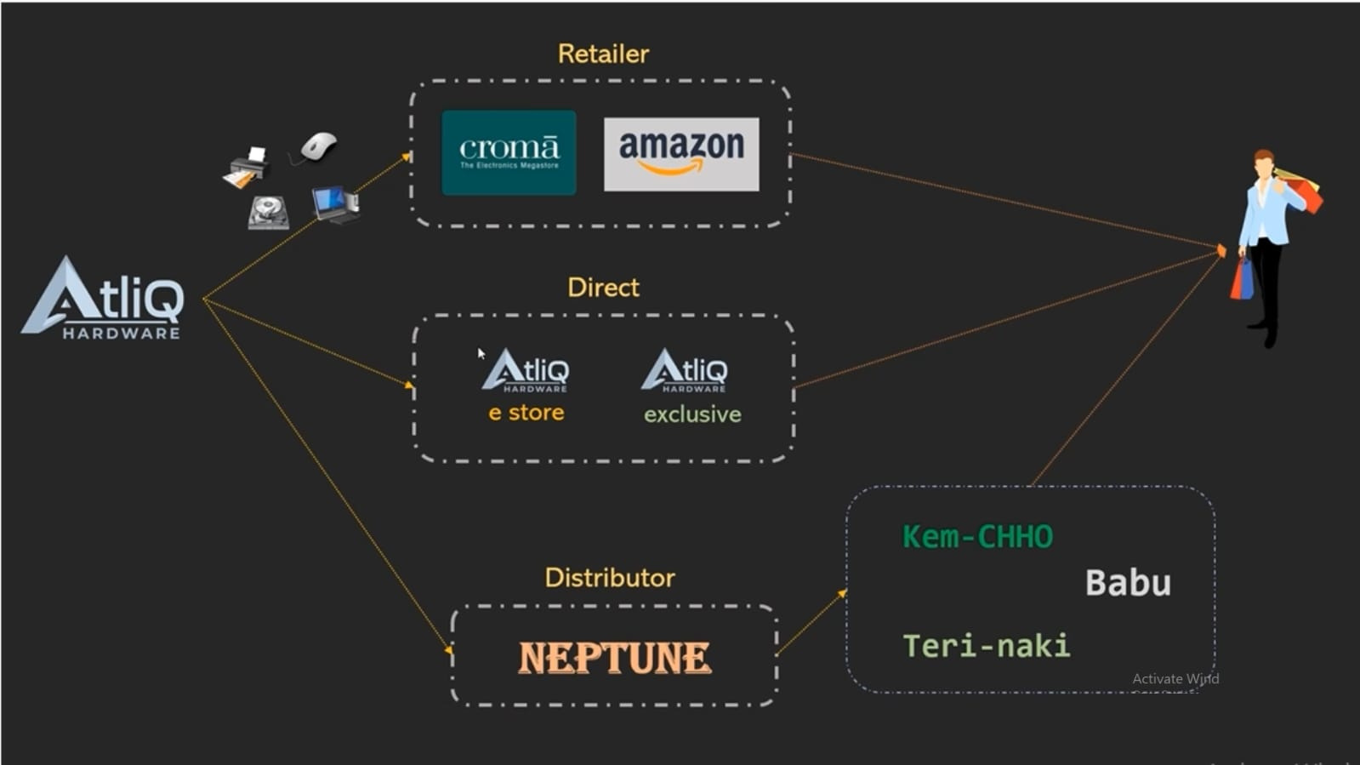
AtliQ Channels
C

Slide 9
Channels
AtliQ sells its products through three main channels
Retailer
Products are sold via e-commerce websites or physical stores to end consumers.
Examples include Flipkart and Best Buy.
Direct
Products are sold directly to consumers through AtliQ’s own stores or online platforms,
such as AtliQ E-Store and AtliQ Exclusive.
Distributor
Products are sold to large distributors in regions where direct sales are restricted.
These distributors then supply local stores. An example is Neptune.

Slide 10
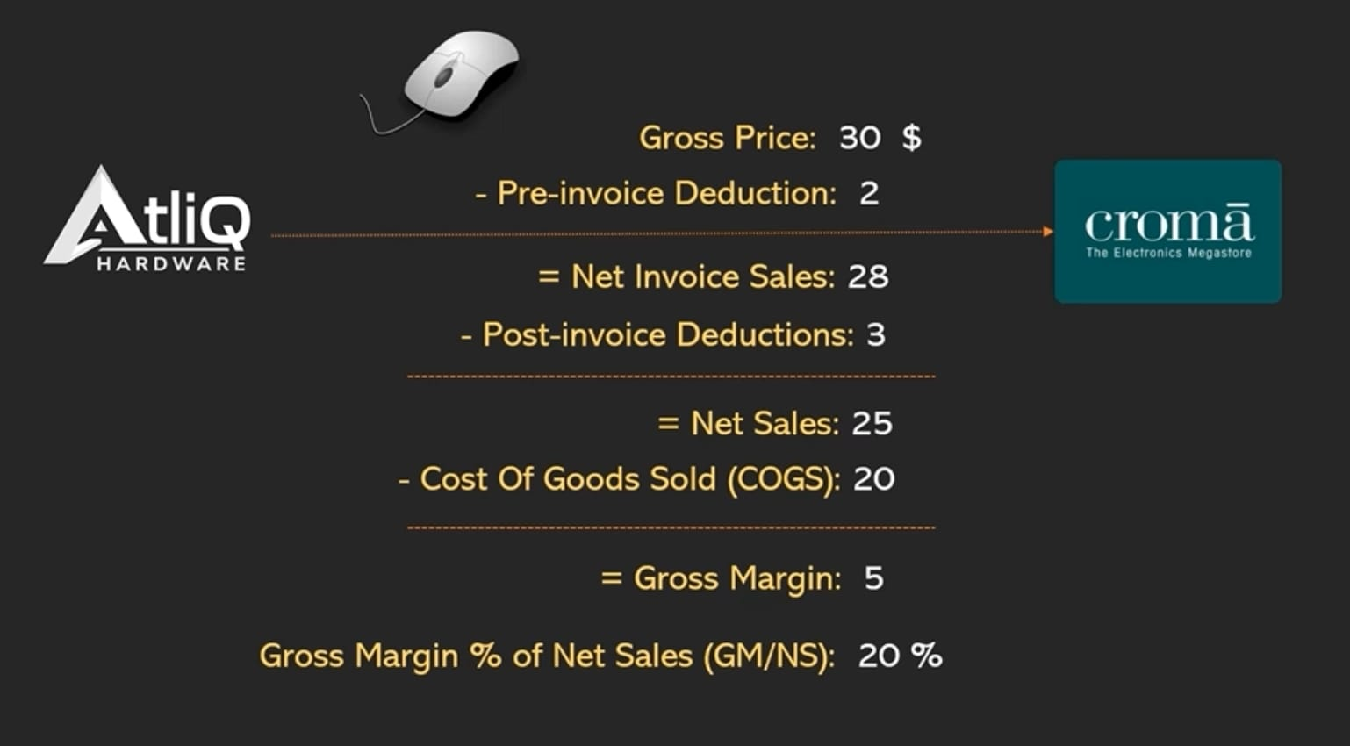
AtliQ Finance
C

Slide 11
Finance
Gross Price: Initial price before deductions.
Pre-Invoice Deductions: Discounts applied before invoicing.
Net Invoice Sales: Amount billed after pre-invoice deductions.
Post-Invoice Deductions: Adjustments after invoicing.
Net Sales: Revenue after post-invoice deductions.
COGS: Direct production costs.
Gross Margin: Net Sales minus COGS.
Gross Margin %: Gross Margin as a percentage of Net Sales.

Slide 12
Thank You

